Slide 1
Z. Gu
Embedded Systems with ARM Cortex-M Microcontrollers in Assembly Language and C
Chapter 12 & 13
Fixed-point and Floating-point Arithmetic
Exercises ANS
Fall 2025
Acknowledgement: Lecture slides based on Embedded Systems with ARM Cortex-M Microcontrollers in Assembly Language and C, University of Maine https://web.eece.maine.edu/~zhu/book/

Slide 2
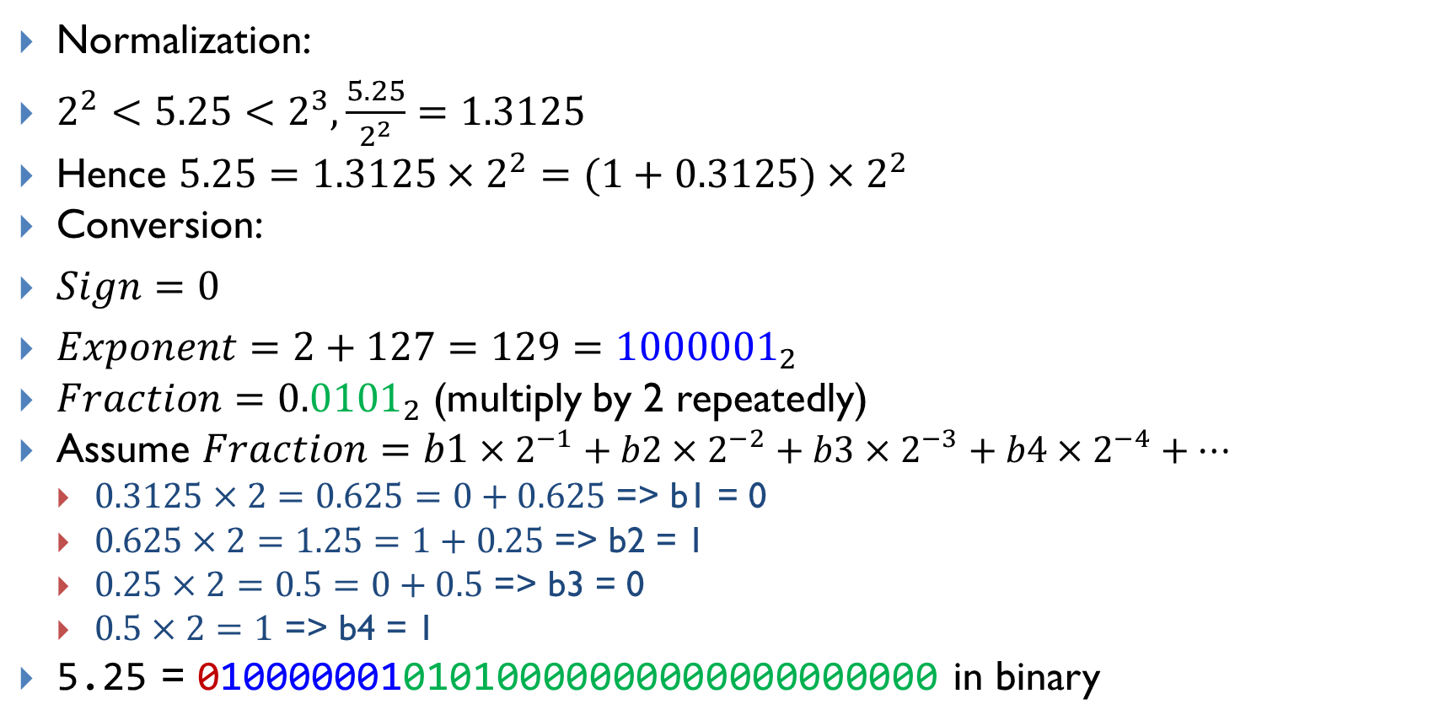
Encoding 5.25 into IEEE Std 754 Single-Precision
Normalization:
$2^{2}<5.25<2^{3},\frac{5.25}{2^{2}}=1.3125$
Hence $5.25=1.3125×2^{2}=(1+0.3125)×2^{2}$
Conversion:
$Sign=0$
$Exponent=2+127=129={1000001}_{2}$
$Fraction={0.0101}_{2}$ (multiply by 2 repeatedly)
Assume $Fraction=b1×2^{−1}+b2×2^{−2}+b3×2^{−3}+b4×2^{−4}+…$
$0.3125×2=0.625=0+0.625$ => b1 = 0
$0.625×2=1.25=1+0.25$ => b2 = 1
$0.25×2=0.5=0+0.5$ => b3 = 0
$0.5×2=1$ => b4 = 1
5.25 = 01000000101010000000000000000000 in binary

Slide 3
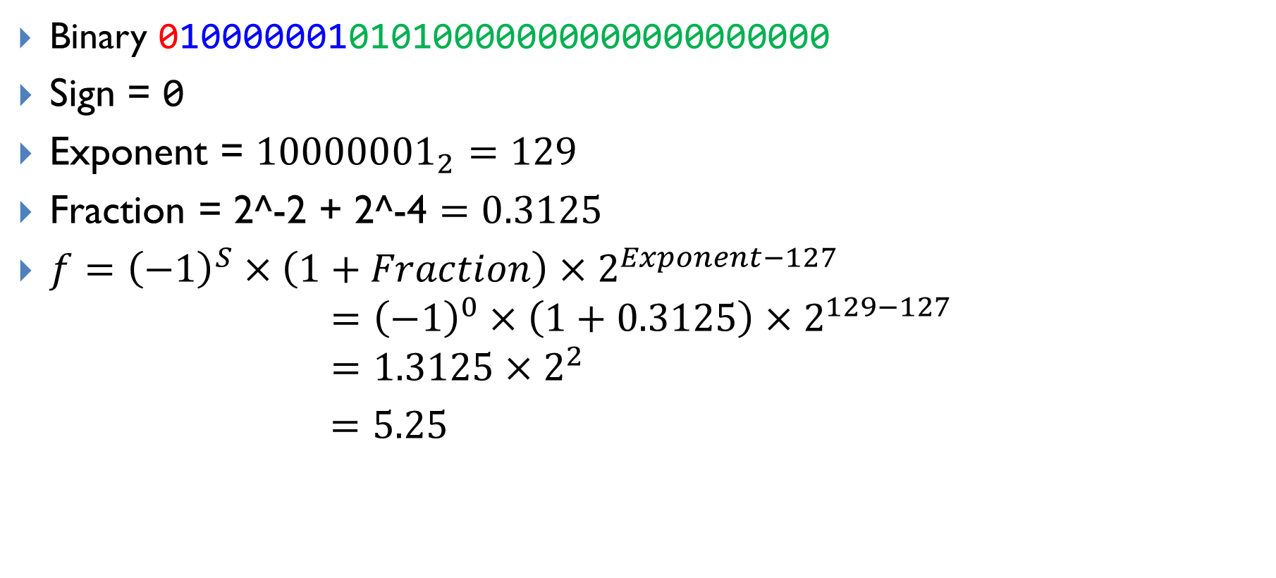
Decoding 01000000101010000000000000000000
Binary 01000000101010000000000000000000
Sign = 0
Exponent = ${10000001}_{2}=129$
Fraction = 2^-2 + 2^-4 $=0.3125$
$f={\left(−1\right)}^{S}×\left(1+Fraction\right)×2^{Exponent−127}$
$$={\left(−1\right)}^{0}×\left(1+0.3125\right)×2^{129−127} \\ =1.3125×2^{2}$$
$=5.25$

Slide 4
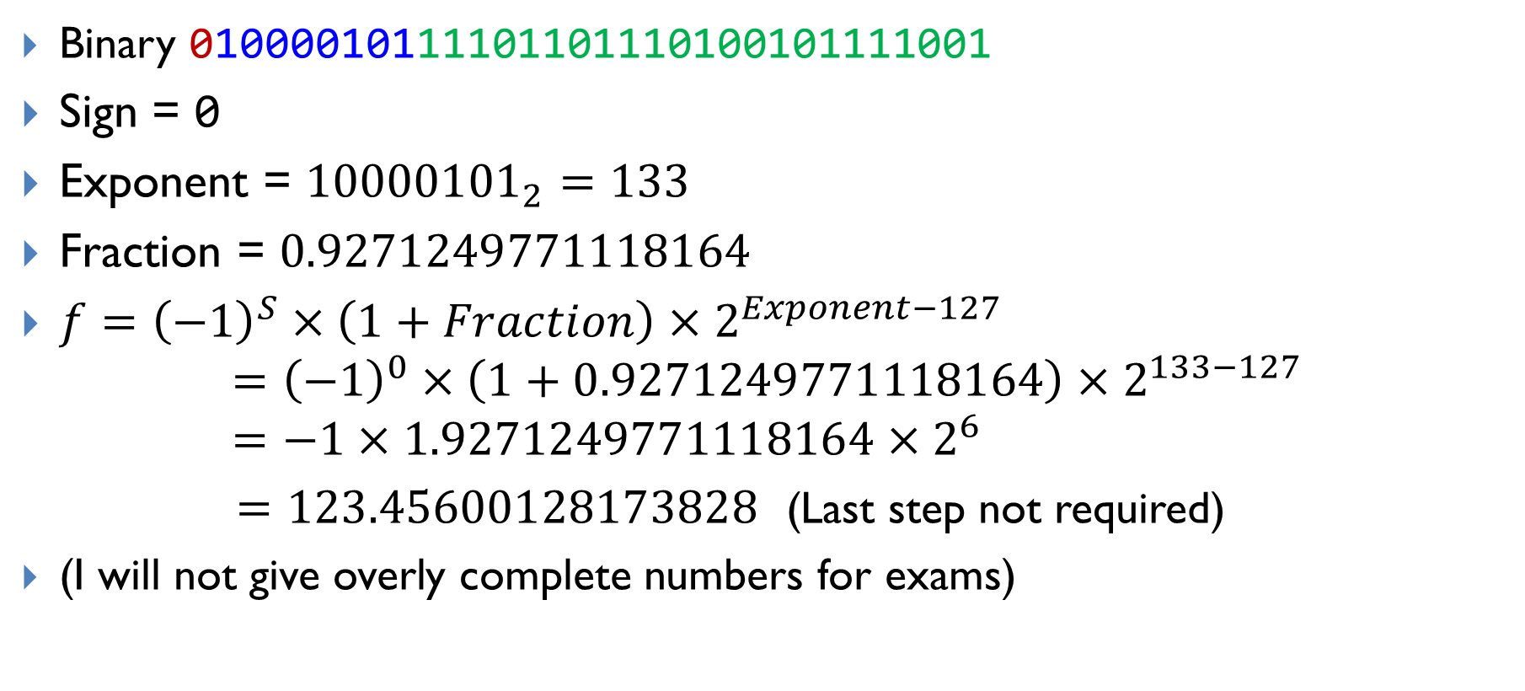
Decoding 0x42F6E979 into a floating-point number
Binary 01000010111101101110100101111001
Sign = 0
Exponent = ${10000101}_{2}=133$
Fraction = $0.9271249771118164$
$f={\left(−1\right)}^{S}×\left(1+Fraction\right)×2^{Exponent−127}$
$$={\left(−1\right)}^{0}×\left(1+0.9271249771118164\right)×2^{133−127} \\ =−1×1.9271249771118164×2^{6}$$ $=123.45600128173828$ (Last step not required)
(I will not give overly complete numbers for exams)

Slide 5
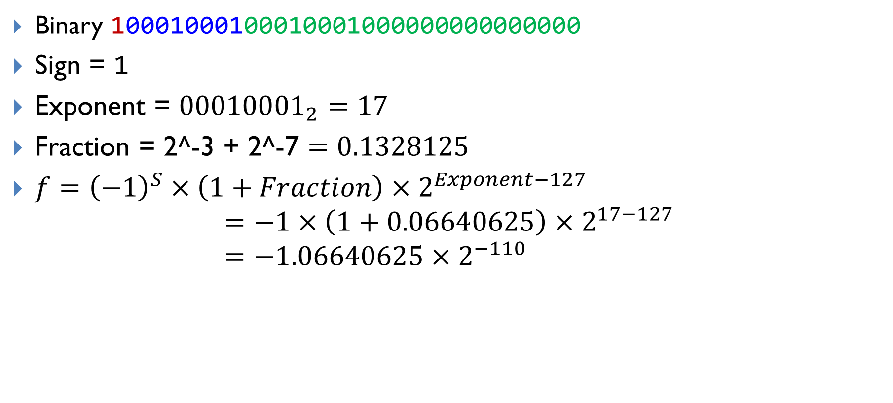
Decoding 0x88888000 into a floating-point number
Binary 10001000100010001000000000000000
Sign = 1
Exponent = ${00010001}_{2}=17$
Fraction = 2^-3 + 2^-7 $=0.1328125$
$f={\left(−1\right)}^{S}×\left(1+Fraction\right)×2^{Exponent−127}$
$$=−1×\left(1+0.06640625\right)×2^{17−127} \\ =−1.06640625×2^{−110}$$

Slide 6
References
IEEE 754 Binary to Float Conversion
https://www.youtube.com/watch?v=9k5rdPUzij8&list=PL-ftFcielQtGxBUfzkbz9tWlRZb-rlJ2p&index=2
IEEE 754 Float to Binary Conversion
https://www.youtube.com/watch?v=9k5rdPUzij8&list=PL-ftFcielQtGxBUfzkbz9tWlRZb-rlJ2p&index=2

